Slide 1

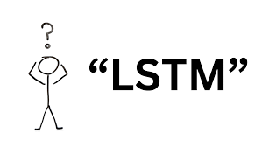
ACTIGNCE - (ACTIonable intelliGENCE)
By: Team – 4
Aneesh Antony Thomas
Neena Philip
Amal Peediyakkal Shaji
Sreelekshmi Rajeshkumar
Virat Ranpariya

Slide 2
ACTIGNCE INTRODUCTION
Objective: Predict financial trends using LSTM to make informed decisions.
Key Challenges:
- Non-linear, noisy nature of financial data.
- Dependence on sequential trends and external indicators.
Proposed Solution: Use Long Short-Term Memory (LSTM) networks, which are ideal for capturing sequential dependencies and mitigating vanishing gradient problems.

Slide 3
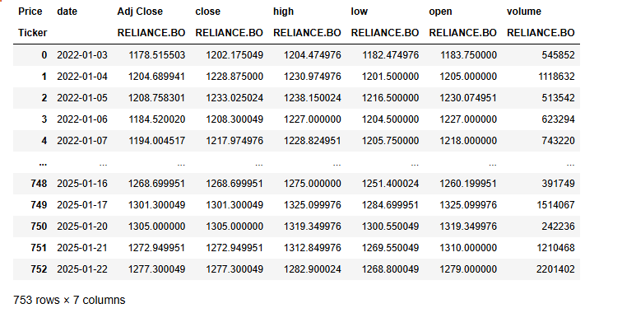

Data Source
Data Source: Historical stock prices

Slide 4
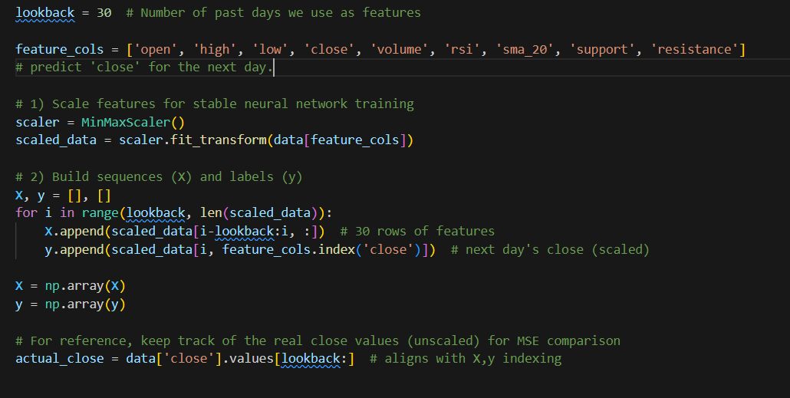
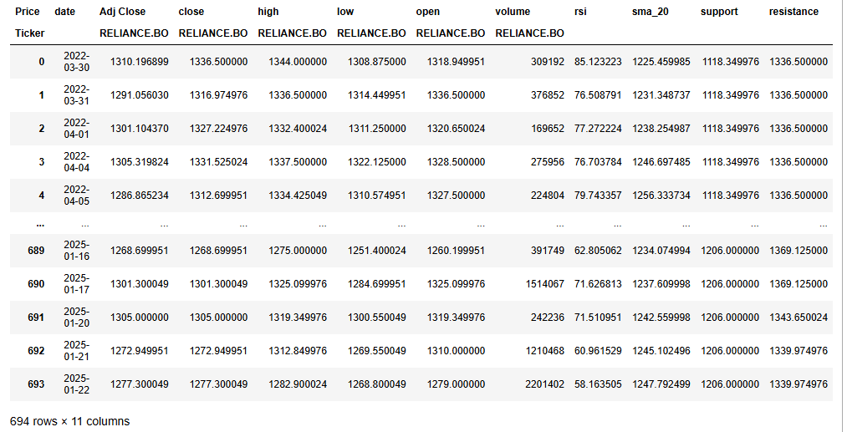
DATA PREPROCESSSING
Preprocessing Steps:
1.Normalization
2.Sequence Generation
3.Train-Test Split

Slide 5
Project Architecture
input_shape=(X_train.shape[1],
X_train.shape[2])
LSTM(64)
return_sequences=True
1st Dropout layer
model.add(Dropout(0.2))
2nd Dropout layer
return_sequences=False
model.add(LSTM(64))
model.add(Dropout(0.2))
model.add(Dense(1))
next day's closing price(a single value)

Slide 6
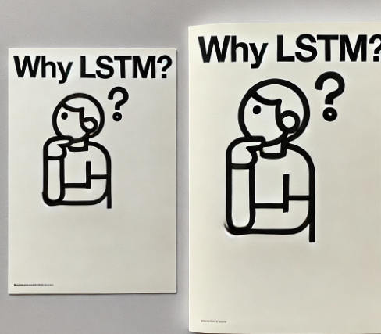
Why LSTM Model ?
Designed to handle sequential data and long-term dependencies.
LSTM can capture patterns in sequences over time, ideal for stock prediction.
Memory cells to store information.
Three gates: Input, Forget, Output.

Slide 7
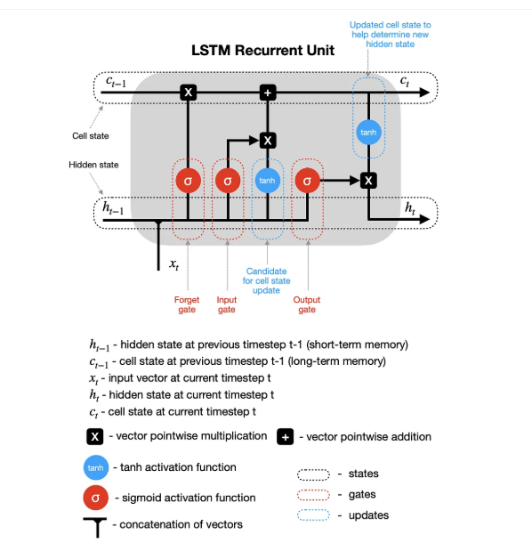

Slide 8
Optimizer : ADAM
Efficient: Combines the strengths of Momentum (faster convergence) and RMSProp (adaptive step sizes).
Adaptive Learning Rate: Each parameter has its own learning rate, which adjusts dynamically during training.
Minimal Tuning: Often works well with default hyperparameters.
Loss Function : mean_squared_error
It quantifies how "wrong" the model's predictions are
provides feedback to guide the optimization process during training.
The goal of the model is to minimize the loss function by adjusting its parameters

Slide 9
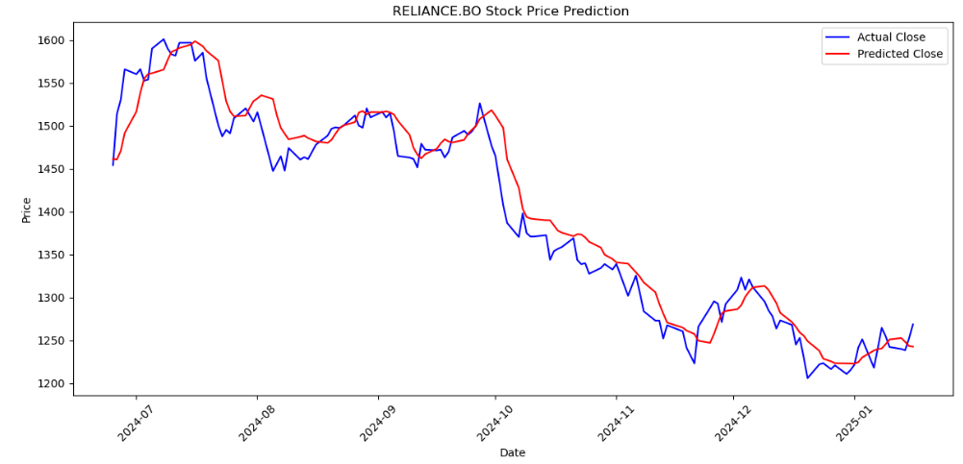
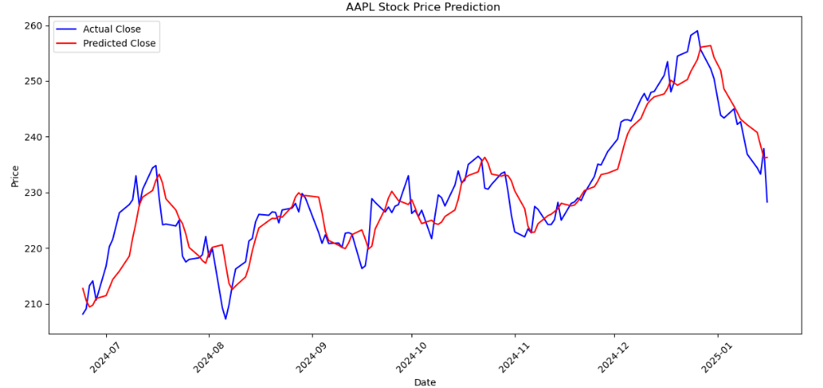
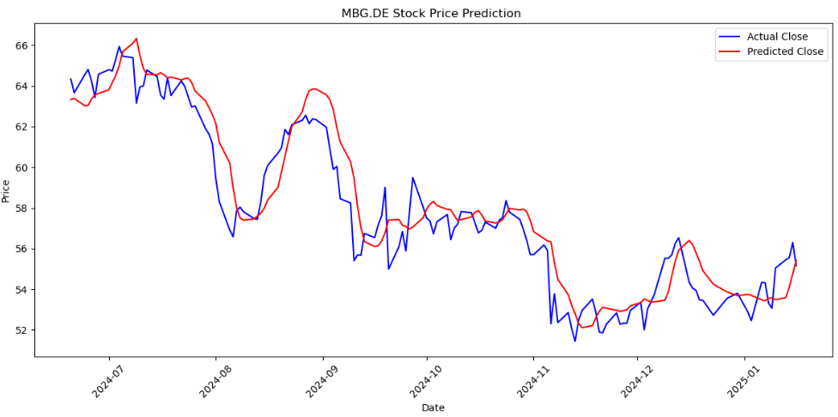
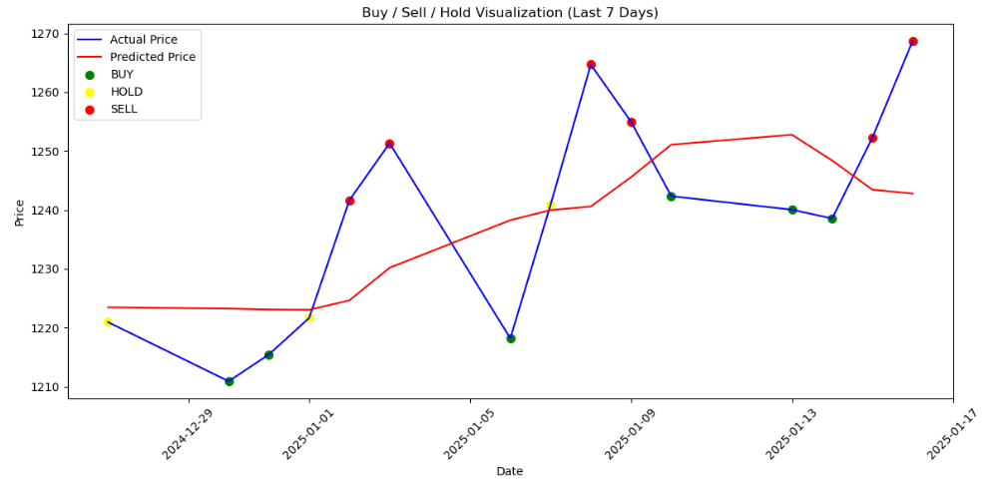
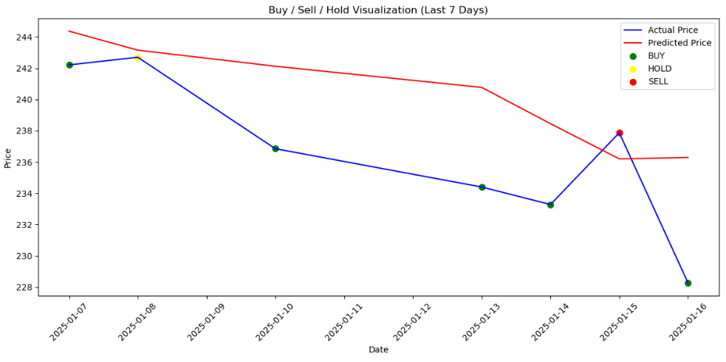
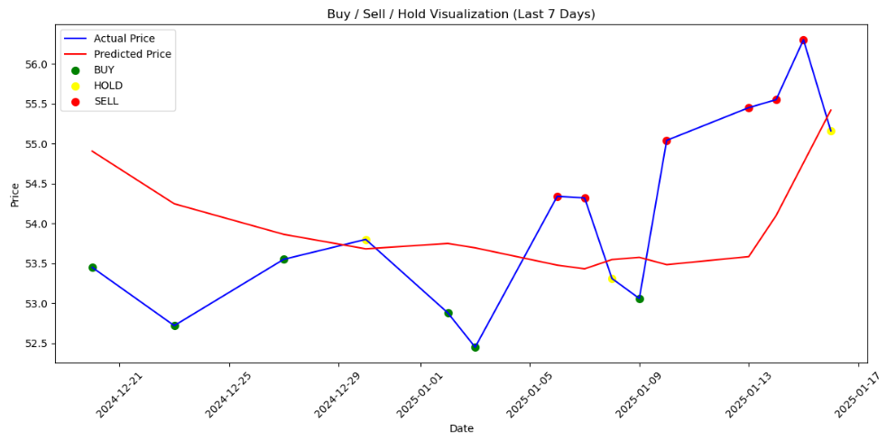
LSTM Model with visualization of actual and predicted values &
Buy Sell Hold
Reliance
Apple
Mercedes-Benz

Slide 10



Model Evaluation
We are using MSE & R² to evaluate performance of the model
Stock name : Reliance (RELIANCE:BO)
Stock name : Apple (AAPL)
Stock name : Mercedes-Benz (MBG:DE)

Slide 11
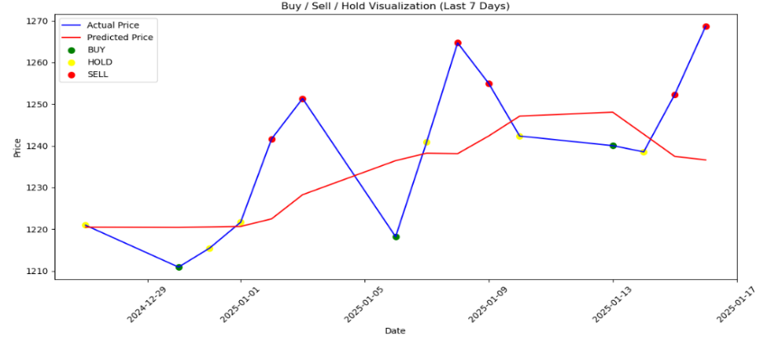
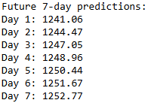

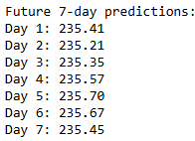
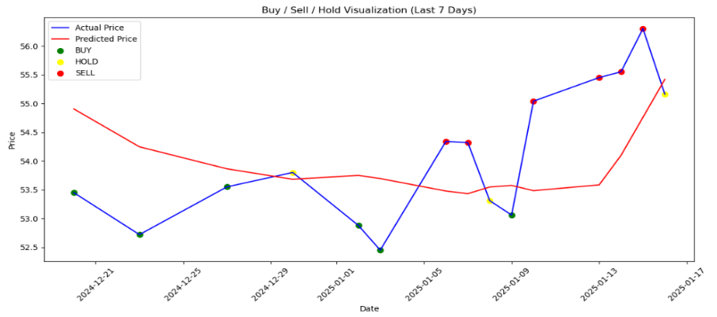
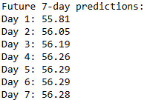
Price prediction & Signaling
Reliance
Apple
Mercedes-Benz

Slide 12
Thank You !
Thank You !

